Slide 1

DEPARTMENT OF COMPUTER SCIENCE AND ENGINEERING MINI PROJECT ON STRENGTHENING CLOUD COMPUTING SECURITY MECHANISMS FOR SECURE KEYWORD SEARCH AND DATA SHARING
BATCH 2020-2024
BATCH -8
TEAM MEMBERS:
N.SOUJANYA(20D41A05E6) M.VIJAY(20D41A05C8) M.NAGARAJU(20D41A05C4) P.PRASHANTH(20D41A05G8)
GUIDED BY:
Mrs K.VIJAYALAKSHMI
Asst.prof.

Slide 2

STRENGTHING CLOUD COMPUTING SECURITY MECHANISMS FOR SECURE KEYWORD SEARCH AND DATA SHARING.

Slide 3
AGENDA
Abstract
Introduction
Existing system
Disadvantages
Proposed system
Advantages
Modules
System requirements
UML Diagrams
Screenshots of execution
Conclusion

Slide 4
ABSTRACT
The main aim of this project is :
The mechanism used to strengthen the data security in cloud computing by using the encryption process like “cipher Text-policy” and Attribute based mechanism with keyword search and data sharing(CPAB-KSDS)
We propose a attribute based keywords searching but also enables sharing the data at the same time.
To enhance the security of keyword search and data sharing in cloud computing environments.
It Implements the technique of cipher text to enhance data confidentiality and protect sensitive information.

Slide 5
INTRODUCTION
Mechanisms for secure keyword search and data sharing plays a crucial role in ensuring the confidentiality and privacy of data.
These mechanisms involves techniques such as Encryption ,access control ,and secure protocols for sensitive information stored in cloud
By implementing these security measures we can mitigate the risks associated with unauthorized access and data beaches.
It is essential for maintaining the integrity and trustworthiness of cloud based system.

Slide 6
EXISTING SYSTEM
The traditional attribute based keywords encryption is not flexible for data sharing and searching .
All the Existing system cloud servers try to share the data in a plain text manner rather than in a encrypted manner.
If the encryption key is exposed the data can be easily accessed by the intruder .
In the existing system there is no security for the data even it is encrypted because there is only single cipher key is generated fir that data.

Slide 7
DISADVANTAGES
All existing schemes are limited to the single owner model
Potential security risks
Concern about the data privacy and loss of data
No confidentially

Slide 8
PROPOSED SYSTEM
The proposed system supports the attribute based mechanism and also supports the data sharing keyword searching.
A secure schema is implemented in the proposed system for the protection of the data.
All of the concerns motivate us to design a mechanism that allows the data owner to search and share the keyword health report without the unnecessary decryption process
The data owner can fully decide who can access the encrypted data.

Slide 9
ADVANTAGES
Provides high security
It is very hard for the user to break the keys
The proposed system is very complex and tough to break the encrypted data without have key permissions
The proposed is efficient to use than the existing system
It is ease to share and search the data in cloud computing

Slide 10
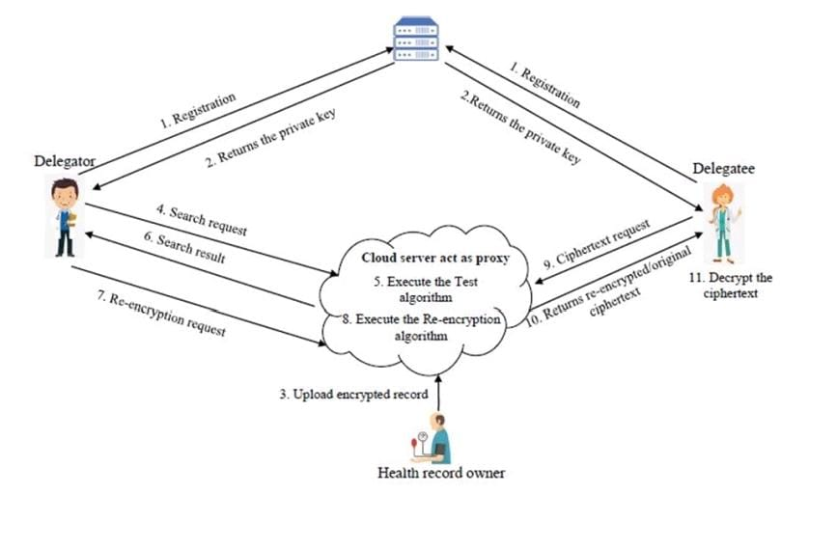
SYSTEM ARCHITECTURE

Slide 11
MODULES
HEALTH RECORD OWNER:Individuals own and manage the information in the PHR, which comes from healthcare providers and the individual. The PHR is maintained in a secure and private environment
DELEGATOR: Delegator is a component that assign tasks or entities to other entities within cloud infrastructure.
DELEGATEE :it refers to the entity that receives the assigned tasks and returning the results back to the Delegator
PKG: It is only type cloud server used to store the information.

Slide 12
SYSTEM REQUIRMENTS
HARDWARE SYSTEM CONFIGURATION:
System :13
Hard Disk : 40GB
Floppy Drive :1.44mb
SOFTWARE SYSTEM REQUIRMENTS:
Technology : java 2 standard edition JDBC
Web Server :Tomcat 7.0
Client web Technologies :HTML , CSS, JavaScript
Server side Technologies :Servlets, JSP
Database server :MYSQL
Editor :Netbeans8.1

Slide 13
UML DIAGRAMS
UML stands for Unified Modeling Language. UML is a standardized general-purpose modeling language in the field of object-oriented software engineering. The standard is managed, and was created by, the Object Management Group.
The goal is for UML to become a common language for creating models of object-oriented computer software. In its current form UML is comprised of two major components: a Meta-model and a notation. In the future, some form of method or process may also be added to; or associated with UML.

Slide 14
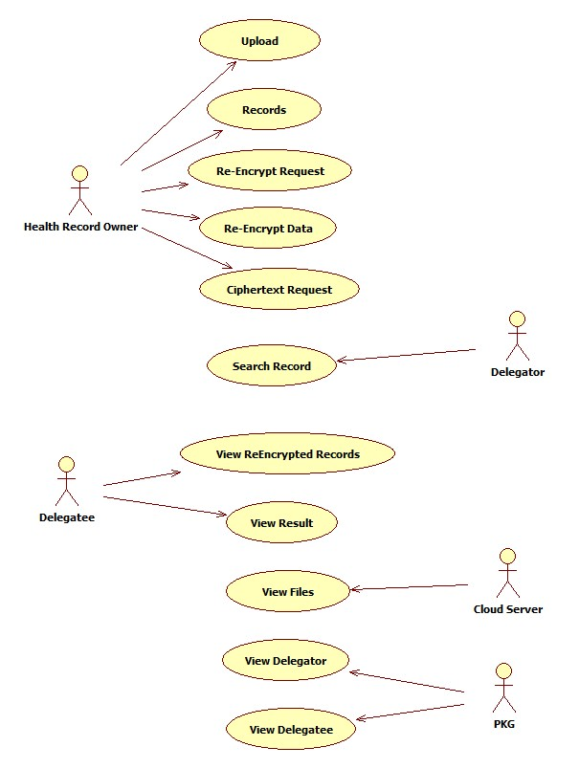
USE CASE DIAGRAM

Slide 15
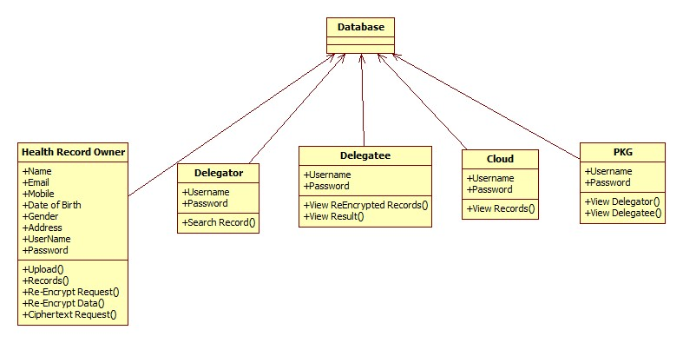
CLASS DIAGRAM

Slide 16
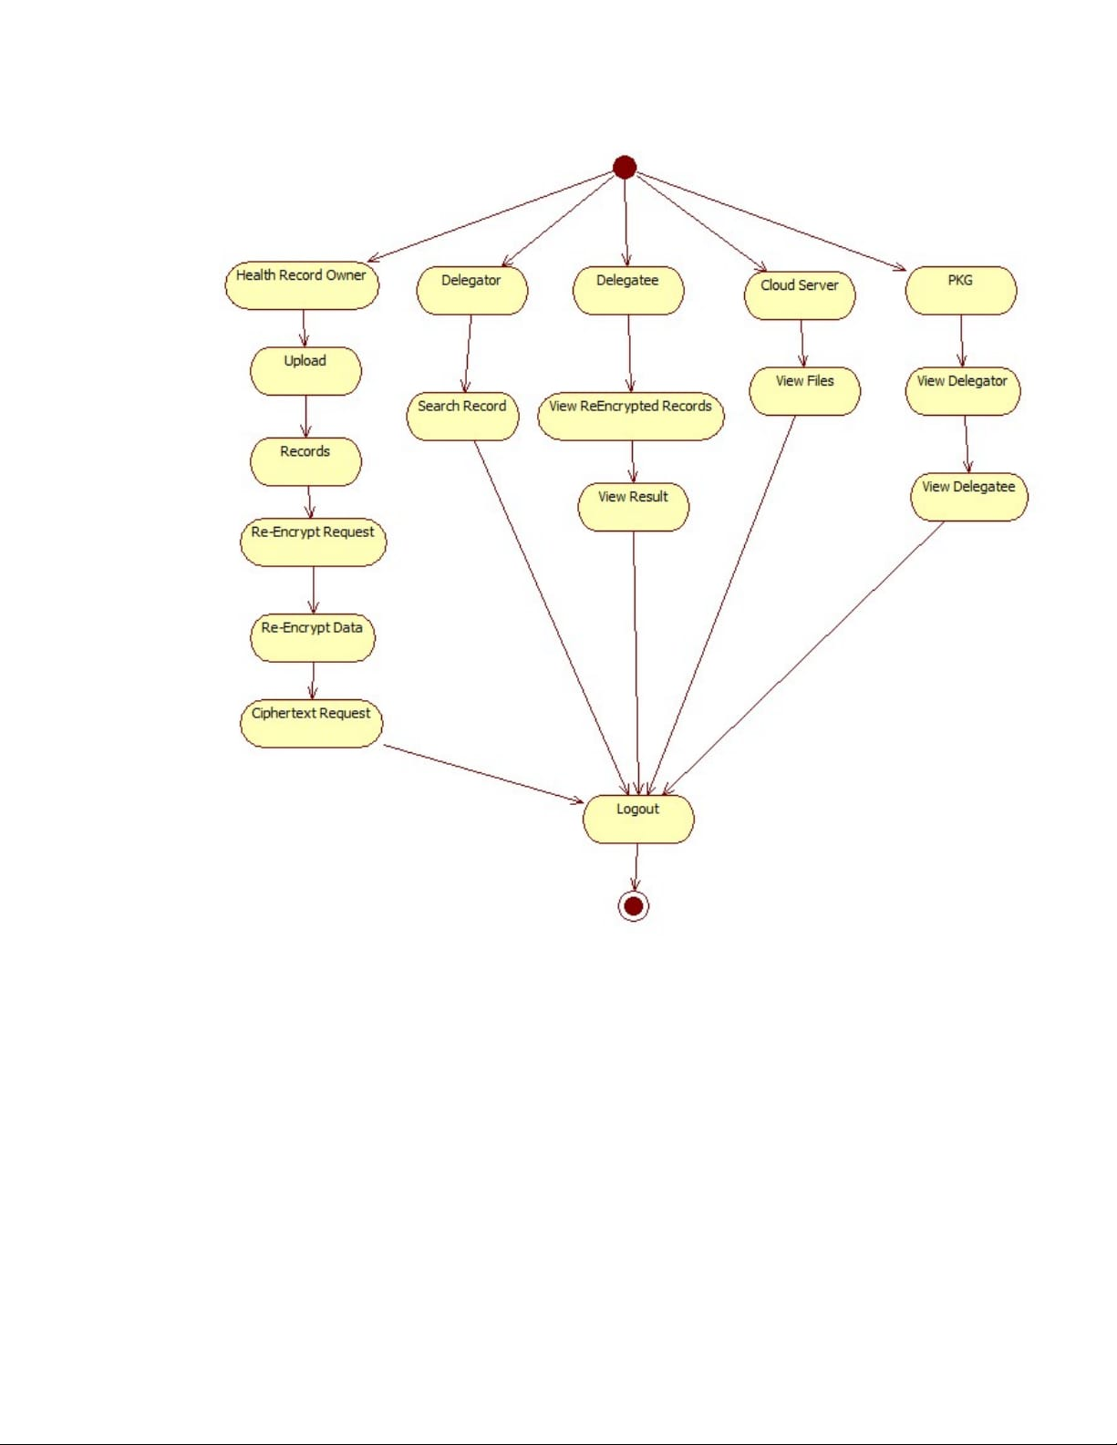
ACTIVITY DIAGRAM

Slide 17
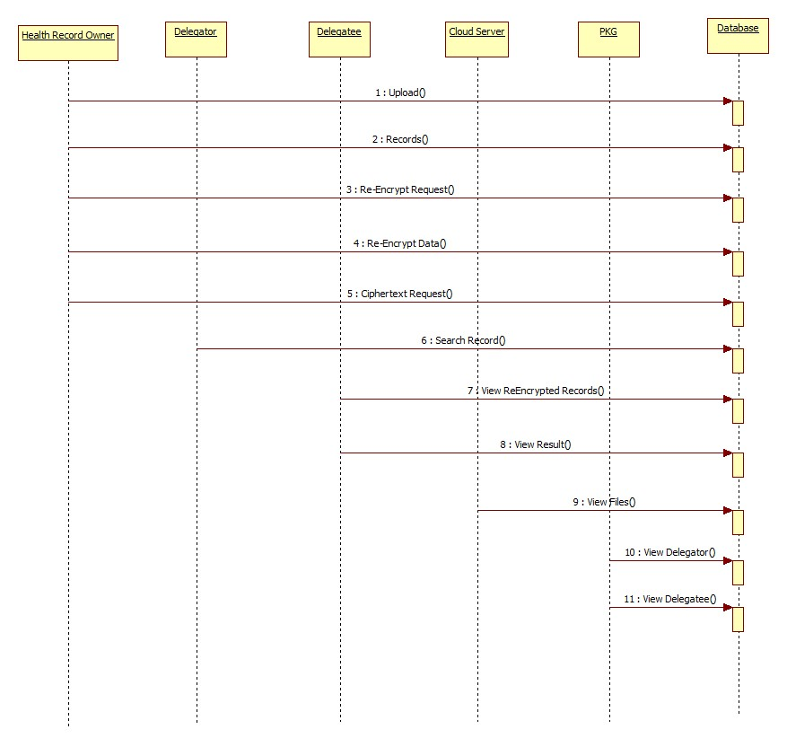
SEQUENCE DIAGRAM

Slide 18
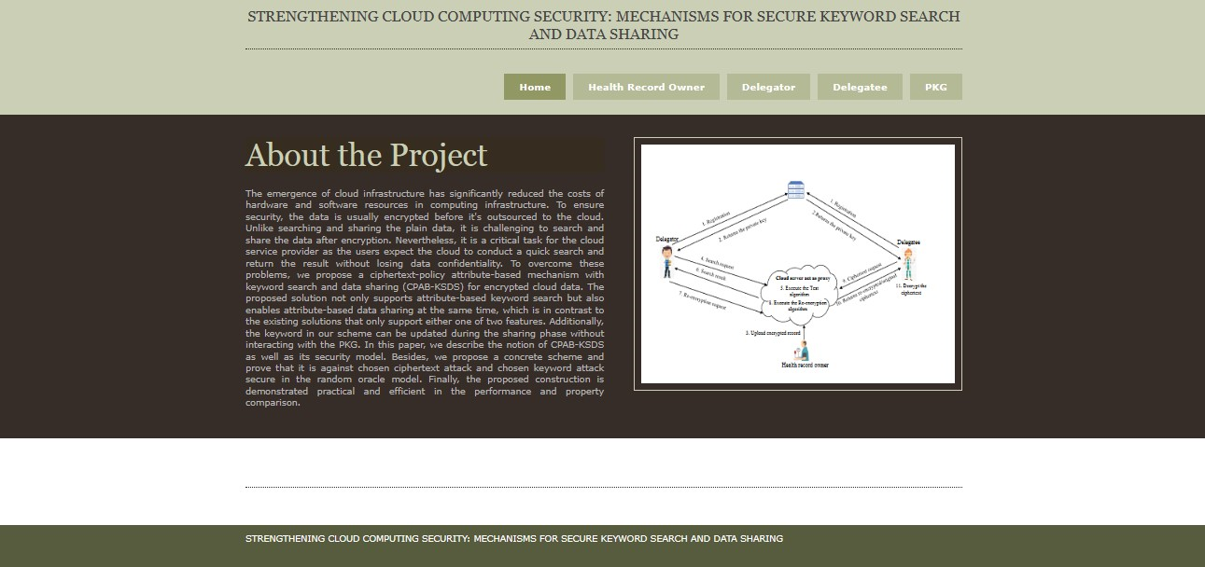
SCREENSHOTS OF EXECUTION

Slide 19
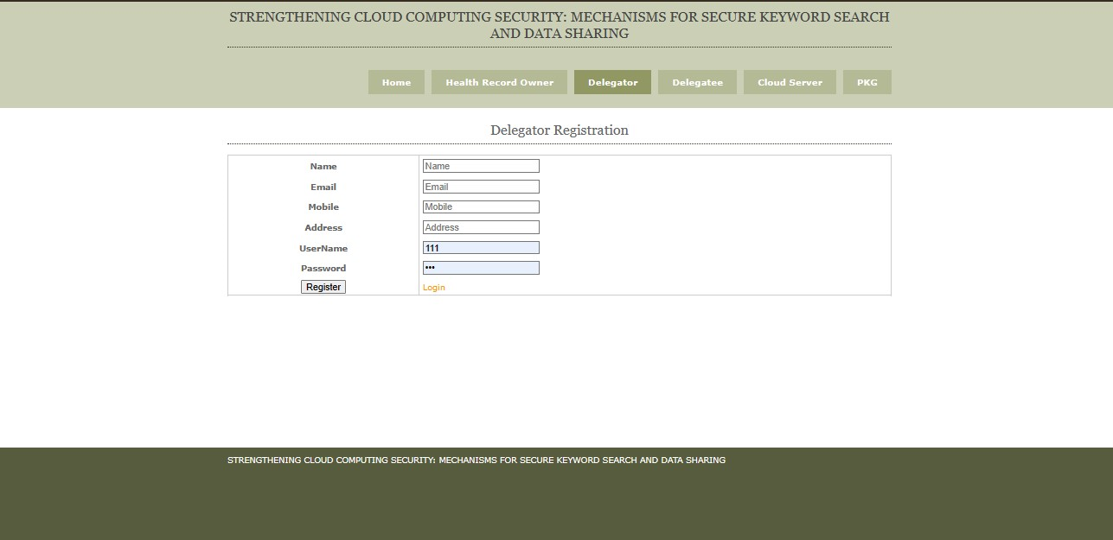
DELEGATOR REGISTRATION

Slide 20
DELEGATEE REGISTRATION

Slide 21
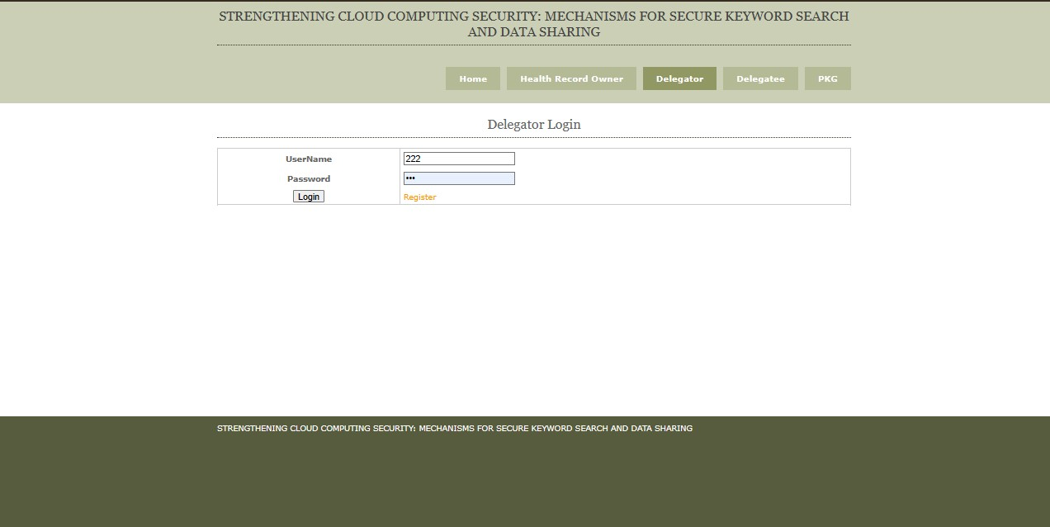
DELEGATOR LOGIN

Slide 22
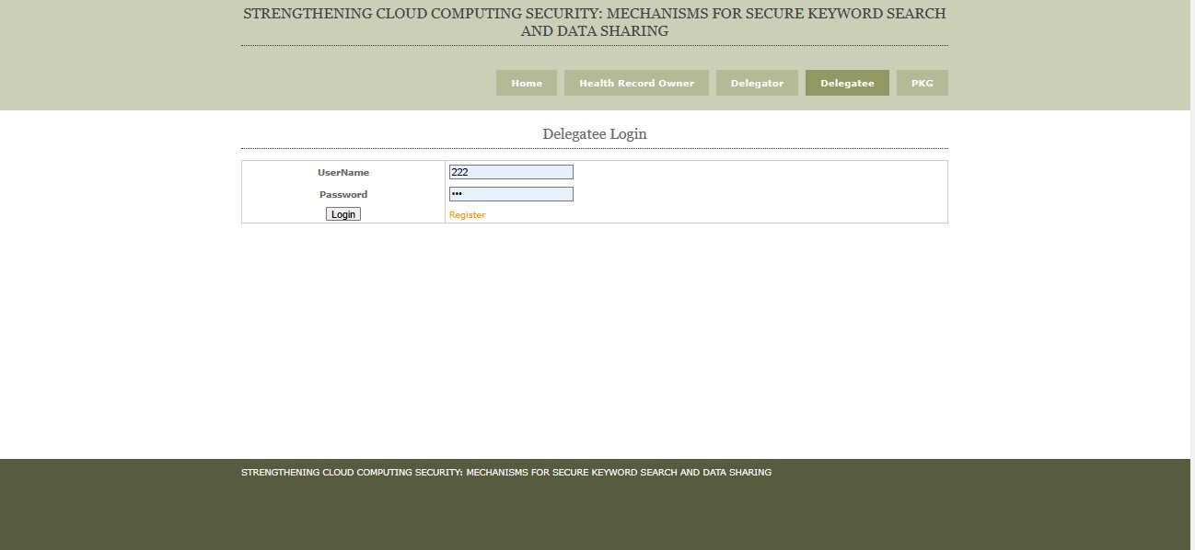
DELEGATEE LOGIN

Slide 23
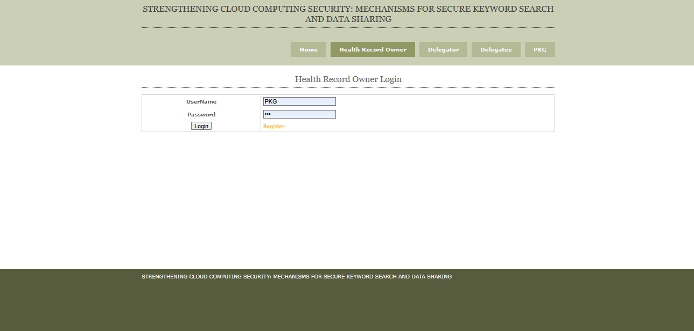
HEALTH RECORD OWNER LOGIN

Slide 24
CONCLUSION
We can conclude that the we have explored the critical need for heightened security in the cloud and discussed various aspects of secure keyword search and data sharing within existing system.
Security should never be afterthought: it must be integrated into the very fabric of our cloud systems
It is a journey that requires commitment ,diligence ,and a shared sense of responsibility.
By taking these steps to fortify our cloud security ,we not only protect our data but also uphold the trust and confidence.

Slide 25
THANK YOU…!!

